Slide 1
Python Basics
Meryl Brodsky, Liaison Librarian for Communication & Information
Karina Sánchez, Scholars Lab Librarian
August 12, 2025
http://bit.ly/4mBcqfs
Check in here: http://bit.ly/4fHMaxS
Notes:
Hi. I am Meryl Brodsky, a liaison librarian here at UT Libraries.
Today I’ll be presenting with Karina Sanchez, the Scholars Lab Librarian.
We are also joined by helpers:
Michael Shensky, Head of the Research Data Services Group
Anna McGilvray, Liaison Librarian for Physical & Computational Sciences
Alex Marden, GIS and Geospatial Coordinator
Bryan Gee, Open Research Coordinator for Data & Software
Jeremy Thompson, Digital Processing Archivist
Ian Goodale, European Studies Librarian
They are on hand to help out if you have a problem or a question. You can just raise your hand.

Slide 2
Welcome
Itinerary for the day
1:00pm - Welcome and introductory slides
Instruction
1:10pm - Google Colab introduction + basic terms for Python
1:30pm - Google Colab Python expressions & operators
Software installation* optional today
2:30pm-3:00pm Python + VS code installation (not needed for tomorrow, but helpful)
Notes:
Here’s our itinerary for today.
This session is geared towards newbie programmers. It’s at a basic level.
You will find that tomorrow’s workshop covers some of the same topics. This is by design. It is to reinforce today’s learnings.
Don’t worry though. By the first 20-30 minutes of tomorrow’s workshop, we will pass where we get to today.
Two things of note, one is that the Software installation is optional today. We will be on hand to help you install Python and VS code. If you’ve had enough at the end of the instruction, and you want to leave, feel free. However, you will need the software installed by Thursday’s session, so please make sure you have it ready to go by Thursday.
Also, there are no scheduled breaks. Please feel free to take a break when you need one.
There are restrooms on this floor, if you go around behind the elevators, you’ll see some restrooms directly across from the University Writing Center.

Slide 3
Land Acknowledgement
We would like to acknowledge that we are meeting on the Indigenous lands of Turtle Island, the ancestral name for what now is called North America.
Moreover, (I) We would like to acknowledge the Alabama-Coushatta, Caddo, Carrizo/Comecrudo, Coahuiltecan, Comanche, Kickapoo, Lipan Apache, Tonkawa and Ysleta Del Sur Pueblo, and all the American Indian and Indigenous Peoples and communities who have been or have become a part of these lands and territories in Texas.
Notes:
Link to the full UTL land acknowledgement- https://www.lib.utexas.edu/land-acknowledgement-statement

Slide 4
Goals - Introduce you to Python
Introduce the fundamental knowledge required to help you start using Python
Learn some of the vocabulary of Python, such as Data Types, Variables, Functions
Use Python without installing any software - this workshop will use Google Colab
Learn about resources to help you when you have a question or a problem
Notes:
Today our goal is introduce you to working with Python. We’ll go over basic vocabulary terms, and you’ll get a chance to actually do some programming using Google Colab, an Integrated Development Environment, and I’ll talk more about what that is in a moment.
Last we’ll talk about how to get help.

Slide 5
What is Python & why should you learn it
Open source programming language
Cross platform compatible (Windows, MacOS, & Linux)
Used in a variety of fields
Large ecosystem of open source packages
Shared code can foster reproducibility
Notes:
Python is:
An open source programming language. This means that it’s free. It’s continuously being updated, and there is a large user community. That user community comes in handy when you have questions or problems.
Python is the fastest-growing language in computer programming.
You should learn it because it is:
Compatible with Windows, Mac & Linux
It’s used in a variety of fields
Flexible, in that is supports working with numerical and textual data
It has many open source packages, which can help to automate certain functions.
A skill desired by employers in many different fields.

Slide 6
What Can You Do with Python
Text Mining
Web Scraping
Data Analysis
Data Visualization
Simulations & Modeling
Notes:
Python can be used for Text mining, that is looking for words or sentiments expressed in text once it is in a machine readable format.
It’s used for Web Scraping, that is to pull data from websites.
It an be used for file management or analyzing data, as well as editing data, and visualizing data – that is creating graphs or charts.
Python is used in scientific fields like physics, chemistry, and bioinformatics for simulations and modeling.

Slide 7
Integrated Development Environment (IDE)
Examples
Benefits
Jupyter Notebooks
Visual Studio
PyCharm
Many others
Easier to write code
Improves code quality
Facilitates code sharing
Notes:
Today we’ll be working with Google Colab, which is an integrated development environment or IDE. An IDE is a software application that provides a user interface for software development.
It’s kind of like a shell that makes working with a programming language a little easier.
IDEs can enhance productivity and efficiency by offering features like code completion, syntax highlighting, noting where there are problems.
It can also help with project management by being able to download replicable code or upload files.
This makes it easier to write code. It improves code quality because it catches typos and other errors, and sometimes make suggestions for fixes. Also, you can share work in an IDE and code with other people.

Slide 8

Google Colab
Colab is a free Google service that allows you to create and run Jupyter Notebooks in the cloud
You can use it to write Python code and text notes in compartmentalized cells within a notebook
Code cells can be run individually to allow for previewing outputs and troubleshooting issues
Notebooks are stored in Google Drive and can access other files in Google Drive
Notes:
Google Colab, is a free, cloud-based environment for writing and executing Python code. It's essentially a browser-based Jupyter Notebook environment, allowing users to combine code, text, images, and other media.
It works particularly well for education because it is browser-based so no software installation is required.
Just so you know, you’ll have access to the Colab Notebooks and to our slides, after the workshop.

Slide 9
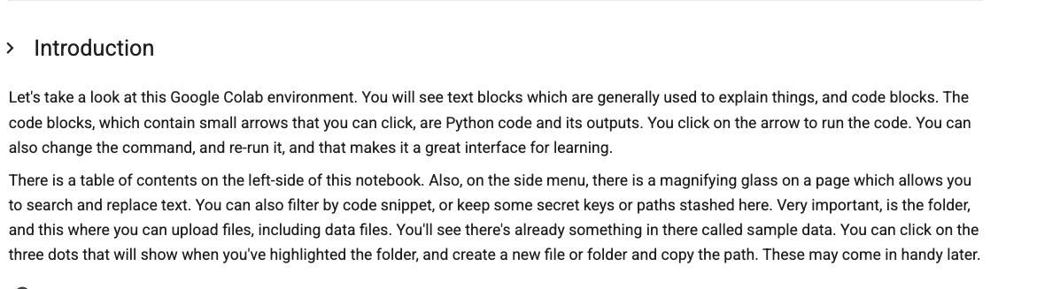
Google Colab Notebook for today
http://bit.ly/40TXfpj
Notes:
Here’s a link to the Colab Notebook we’ll use for today’s workshop. You can open it up now.

Slide 10

Post programming
Where to find Help
Software installation
Image: Wong, Tommy. (July 5, 2006). https://www.flickr.com/photos/gracewong/183286968
Notes:
Date 5 July 2006
Source https://www.flickr.com/photos/gracewong/183286968
Author Tommy Wong
Permission: (Reusing this file) Free content licence.

Slide 11
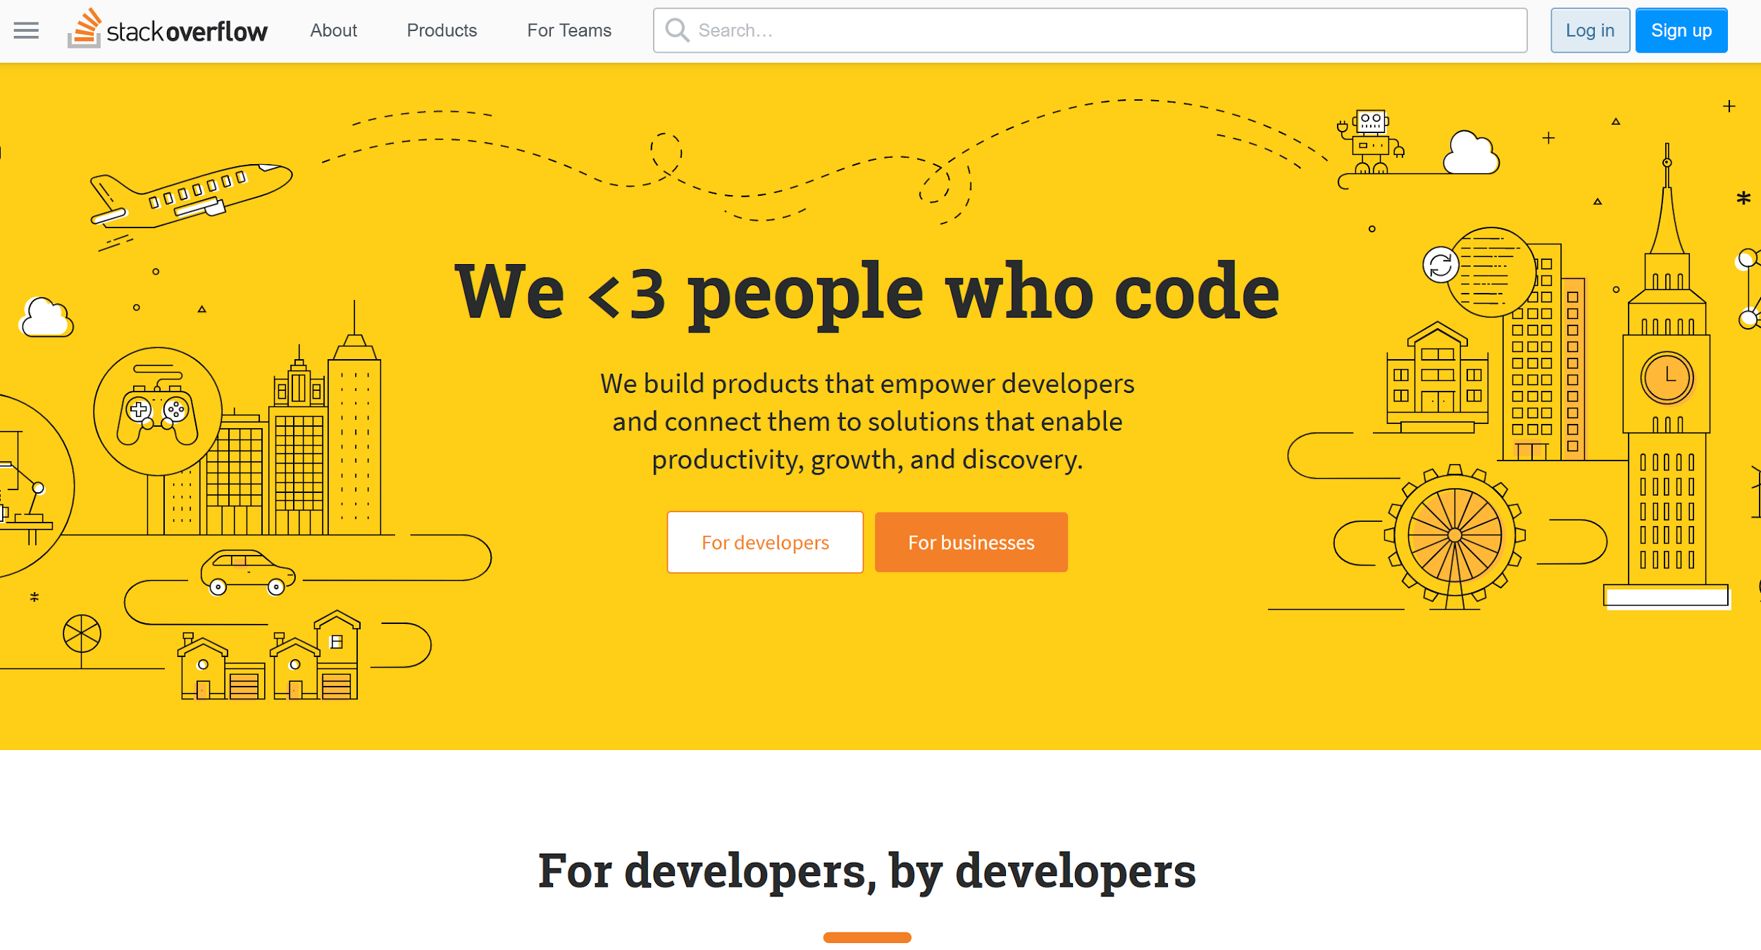
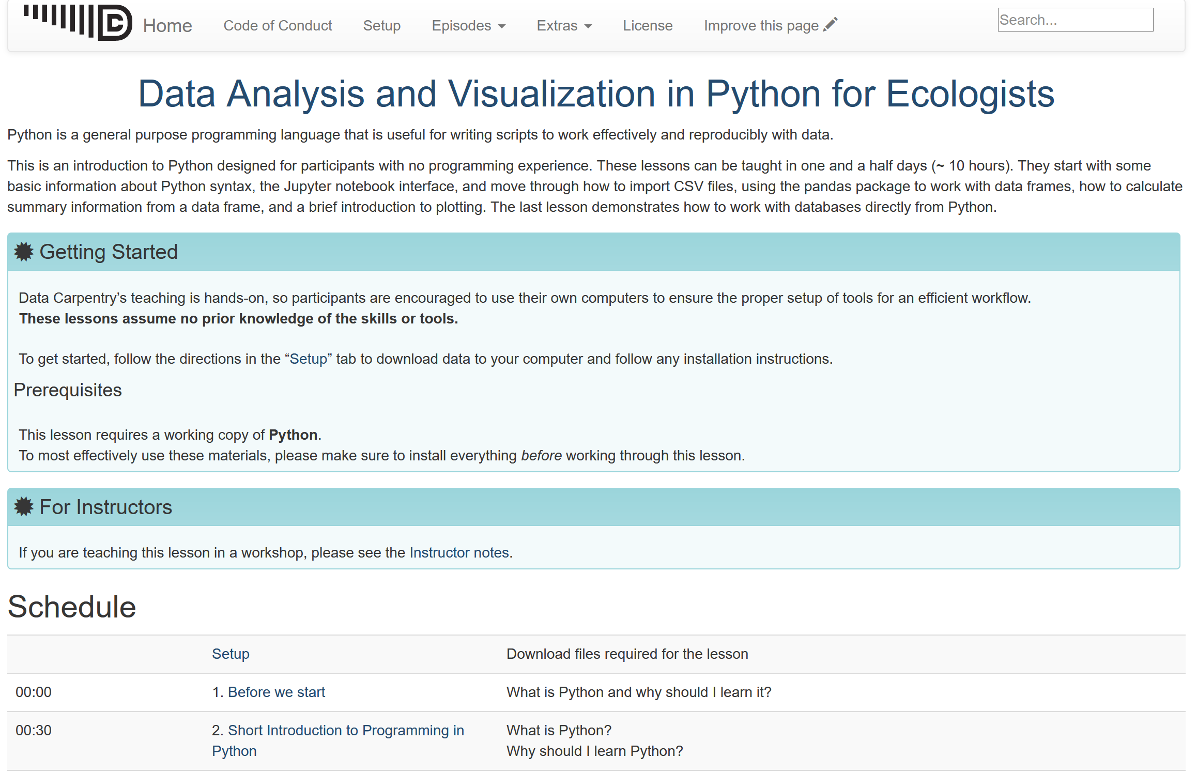
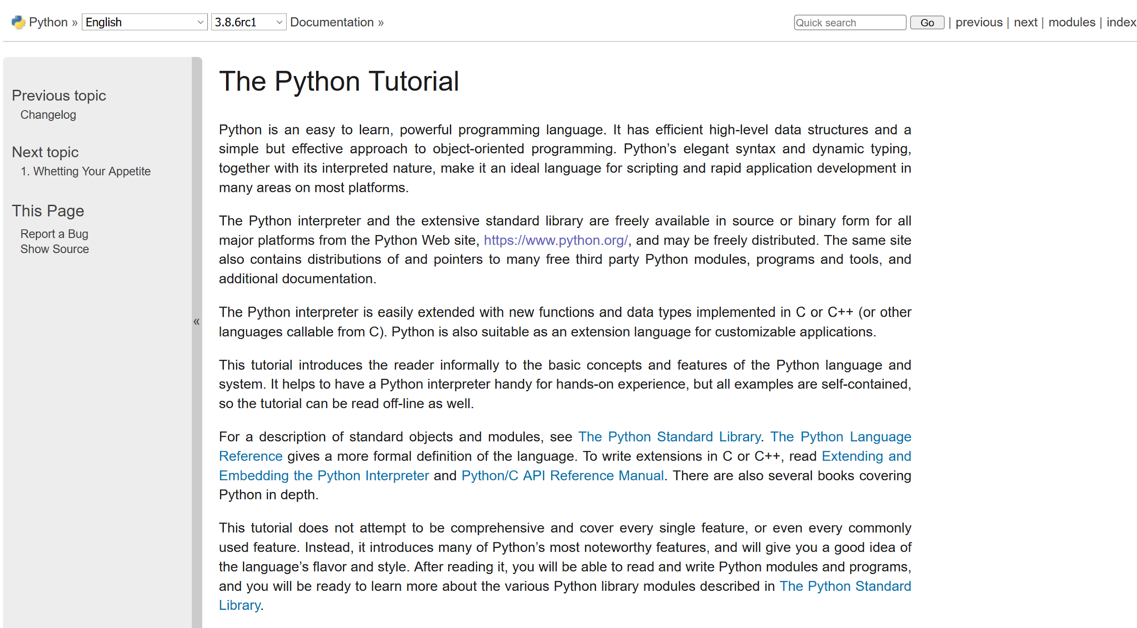
Helpful Resources
Stack Overflow (https://stackoverflow.com/)
Data Carpentry (https://datacarpentry.org/python-ecology-lesson/)
Python Documentation (https://docs.python.org/3/library/index.html)
Python Glossary
(https://www.w3schools.com/python/python_ref_glossary.asp)
Python Tutorial (https://docs.python.org/3/tutorial/index.html)
LinkedIn Learning (https://www.linkedin.com/learning/topics/python)
UT Statistics Short Courses (https://stat.utexas.edu/training/software-short-courses)
Google Colab: Intro to Python (https://colab.research.google.com/notebooks/intro.ipynb)
Notes:
Here are some extra resources that we have found to be helpful.
If you search for help when you’re having a question or problem, you can also use Google and thai will likely turn up responses from Reddit or Stack Overflow.

Slide 12
Thank you for coming!
http://bit.ly/41x9ubz
Questions?
Meryl Brodsky: Meryl.Brodsky@austin.utexas.edu
Karina Sánchez: karinasanchez@austin.utexas.edu
Please keep this slide for attribution
Notes:
Please fill out our assessment form linked here.

Slide 13
Software Installation*
*This is optional today
Install
Python
VS Code
Notes:
There are four different pieces of software that we will use during Thursday’s workshop, including Git and Github. Today we’re focusing on Python and Visual Studio Code (an IDE for Python)
If you like, you can install them now, or begin to install them, and we will be on hand to help you.
If you’ve had enough today, feel free to leave, and we’ll see you tomorrow.
You’ll have another opportunity to install this software at the end of tomorrow’s workshop.
Also, tomorrow, you may see or hear some of the same concepts that we discussed today. It’s not all the same, and tomorrow’s workshop will move on from the introductory material pretty quickly.

Slide 14
Installing Python - Windows
Python (https://www.python.org/downloads/)
Test
Make sure you can install new Python packages using the Command Prompt on Windows
Type the following command on your Windows: python -m pip install pandas
VSCode (https://code.visualstudio.com/download)
Test
Create a new file with the extension .py (to designate the file as a Python script)
Click the play/run button in the upper right corner of VSCode to run the script
Git (https://git-scm.com/downloads)
Github Desktop (https://desktop.github.com/download/)

Slide 15
Installing Python - Mac
Python (https://www.python.org/downloads/)
Test
Make sure you can install new Python packages using the Terminal (MacOS)
Type the following command on your Mac: python3 -m pip install pandas
VSCode (https://code.visualstudio.com/download)
Test
Create a new file with the extension .py (to designate the file as a Python script)
Click the play/run button in the upper right corner of VSCode to run the script
Git (https://git-scm.com/downloads)
Github Desktop (https://desktop.github.com/download/)

Slide 16
Troubleshooting Windows & Mac
Link to document here:
http://bit.ly/3J8adK2
Notes:
This is a troubleshooting document. You can use it if the standard downloading instructions don’t work.
You may have other issues, depending on whether your computer is owned by the university and you’re a staff person, or the age of your computer, or whether you’ve downloaded python and vs code before.

